Slide 1


KEY LOGGER
APSSDC
PAGOLU HARSHINI

Slide 2

INTRODUCTION
A keylogger, short for keystroke logger, is a type of surveillance technology used to monitor and record each keystroke typed on a computer's keyboard. This data is then stored locally or transmitted to a remote server.
Legitimate Uses: Keyloggers can be used by employers to monitor employee activity, by parents to supervise their children's computer usage, and for other lawful monitoring purposes.

Slide 3

AGENDA
Introduction to the keylogger application. This application captures keyboard events and stores them in both text and JSON formats.
The key components used are:
Tkinter: For creating the graphical user interface (GUI).
pynput: For capturing keyboard events.
JSON: For storing keypress data
Technologies Used
Programming Languages:
Python
Keystroke Capture Libraries:
pynput
pyHook (for Windows)
keyboard (cross-platform)
Development Tools:
Integrated Development Environment (IDE) like PyCharm or Visual Studio Code
Version control system like Git
Testing and Analysis Tools:
Virtual machines or sandbox environments for safe testing
Log analysis tools

Slide 4

PROBLEM STATEMENT
Cybersecurity Threat
Increasing Threat of Keyloggers:
Keyloggers are becoming more sophisticated and harder to detect.
Frequently used by cybercriminals to gather sensitive information.
Impact on Users
Consequences of Keylogger Attacks:
Data Breaches: Capture login credentials, leading to unauthorized access.
Financial Loss: Stolen financial information can result in monetary loss.
Identity Theft: Personal information used for identity theft, causing long-term damage.

Slide 5

Project
Overview
The primary goal of this project is to develop and analyze a keylogger for educational purposes. This includes understanding how keyloggers function, their potential impacts, and how to defend against them.
Scope
Development Phase:
Design and implement a basic keylogger using programming languages and libraries.
Testing Phase:
Test the keylogger in a controlled environment to evaluate its functionality.
Analysis Phase:
Analyze the captured data to understand the keylogger's effectiveness.

Slide 6


WHO ARE THE END USERS?
The end users of this keylogger program could be individuals or organizations looking to monitor and track keyboard activity for security or monitoring purposes. However, it is essential to use such tools responsibly and ethically.

Slide 7

SOLUTION & VALUE PROPOSITION
Creation for Educational and Defensive Purposes:
Purpose: An ethical keylogger is designed to be used as a tool for educational and defensive cybersecurity purposes.
Educational Use:
Demonstrates how keyloggers operate, providing insights into their mechanisms and behaviors.
Defensive Use:
Assists in developing robust security measures by understanding potential vulnerabilities exploited by malicious keyloggers.
Defensive Strategies:
Building Resilience:
Helps in creating more resilient security systems by knowing the tactics and techniques used by attackers.
Enhanced Detection:
Contributes to the development of advanced detection tools and methods to identify and neutralize keyloggers.

Slide 8



TECHNICAL IMPLEMENTATION
User Input Device (Keyboard): The source of keystrokes.
Keylogger Software/Hardware:
Kernel-Level Keylogger: Intercepts keystrokes at the kernel level.
Application-Level Keylogger: Monitors keystrokes at the application level.
Data Capture Module: Captures and records keystrokes.
Data Storage Module: Stores captured keystrokes locally or sends them to a remote server.
Data Transmission Module (for remote keyloggers): Sends captured data over the network to the attacker.

Slide 9

MODELLING
The keylogger program is designed to listen for keypress and release events using the pynput library. It categorizes the keys as pressed, held, or released and saves this information in both a text file ('key_log.txt') and a JSON file ('key_log.json'). The GUI built with Tkinter includes buttons to start and stop the keylogger, along with a label to display the program's status.

Slide 10

RESULT
Python script for a basic keylogger using Tkinter for the GUI and the pynput library to capture keyboard inputs. The script defines functions to generate text and JSON log files of the keystrokes captured. It also sets up functions to start and stop the keylogger.

Slide 11
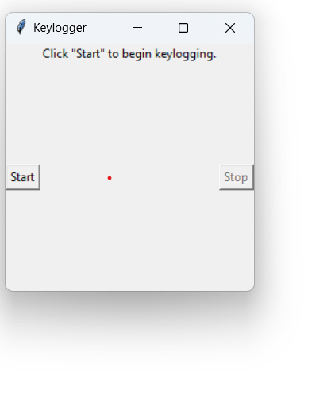
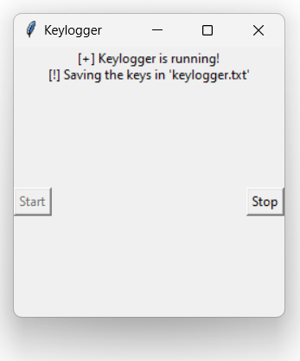
Project Link
https://github.com/Harshi4741/-Harshini_Project.git

